Slide 1
OUR VOICE
A program made by students, for the students
SPEAK YOUR MIND. SHAPE OUR FUTURE.

Slide 2
AGENDA
目录
  Introduction
  Follow-ups
  New Updates

Slide 3
OUR VOICE
你有遇到过对学校有想法、建议、意见无处诉说的情况吗？
Do you have suggestions, discontent, or ideas that you want to share but have no one to talk to?

Slide 4
YOU
OUR
US
Our Voice

Slide 5
“
ourvoice@hd.kaiwenacademy.cn
“
build a better campus

Slide 6
WHAT CAN
YOU
DO?
  Your suggestions:
    school departments, activities
  Your ideas：
    clubs, initiatives, projects
  Your questions:
    Our duties, activities...
  Promote your initiatives:
    Programs, shows, clubs...
🤔

Slide 7
FOLLOW-UPS

Slide 8
FACE PAYMENT IS
CURRENTLY UNAVAILABLE
☕
目前无法使用扫脸支付
Alipay and WeChat face payment are both unavailable for now.
支付宝和微信目前均无法通过扫脸完成支付。
📩
PAYMENT BINDING INSTRUCTIONS
The Division will send the instructions again by email.
学部将通过邮箱再次发送咖啡厅支付绑定说明。
OUR VOICE
SPEAK YOUR MIND. SHAPE OUR FUTURE.

Slide 9
NEW UPDATES

Slide 10
ARE OUR VOICE AND THE
STUDENT COUNCIL THE SAME ORGANIZATION?
NO
我们和学生会是同一个组织吗？
OUR VOICE FOCUSES ON HELPING STUDENTS
RAISE CONCERNS AND SOLVE PROBLEMS.
我们更关注倾听大家的声音，并帮助大家解决实际问题。
💬 🤝
OUR VOICE
SPEAK YOUR MIND. SHAPE OUR FUTURE.

Slide 11
NEW WEBSITE

Slide 12
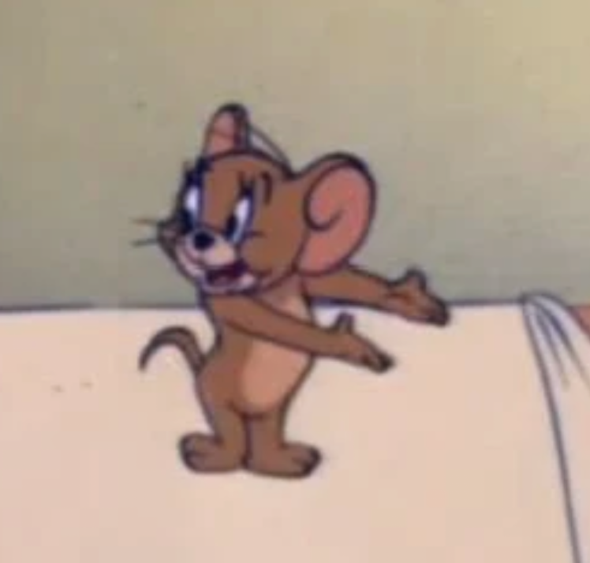
03 JOIN OUR VOICE / 招新
JOIN OUR VOICE
✨
和我们一起，让改变发生
We are looking for students who are just as
PASSIONATE ABOUT MAKING PROGRESS.
我们期待同样热爱推动进步的你加入。
SPEAK YOUR MIND.
SHAPE OUR FUTURE.
OUR VOICE
SPEAK YOUR MIND. SHAPE OUR FUTURE.

Slide 13
📩
ourvoice@hd.kaiwenacademy.cn
SHARE YOUR VOICE WITH US
欢迎随时与我们分享你的想法
OUR VOICE
SPEAK YOUR MIND. SHAPE OUR FUTURE.

Slide 14
THANK YOU FOR WATCHING 🥰
Annie Wu Yuhong Luo Edith Zou

